Slide 1
Moody Portal Orientation

Slide 2
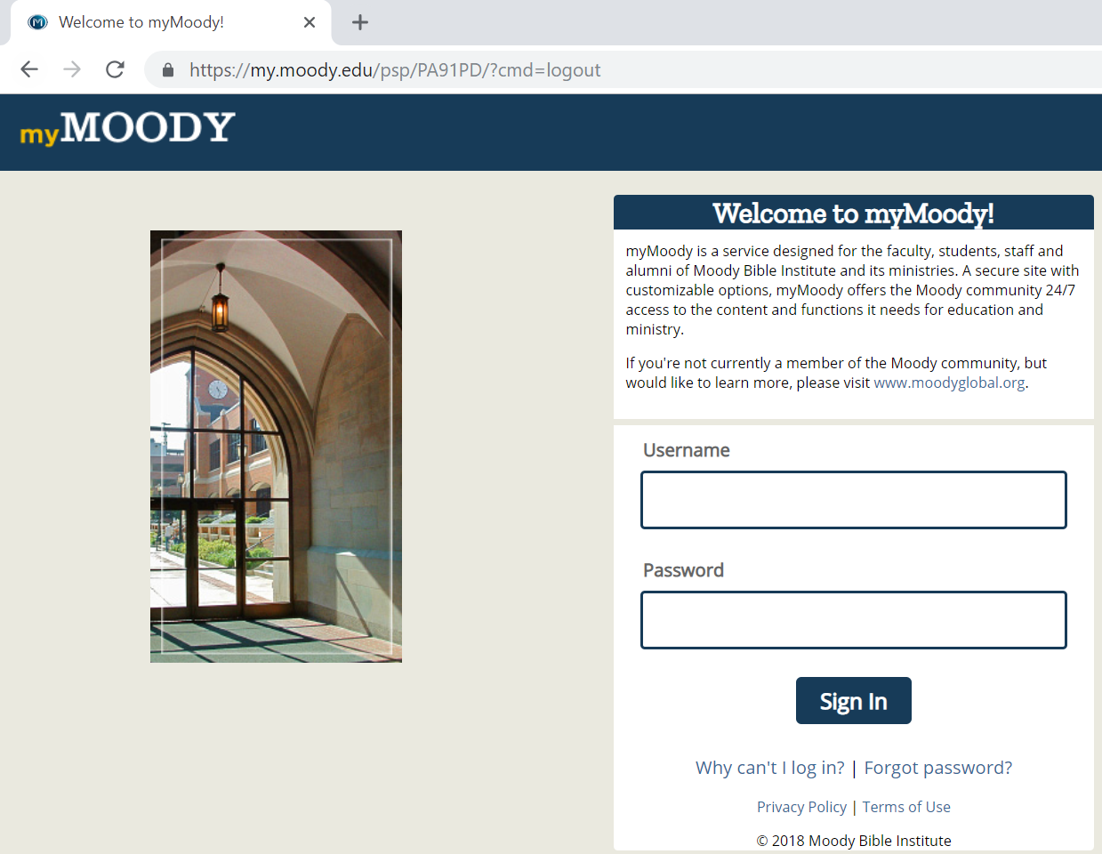
How to: Access your Student Portal
Go to my.moody.edu
Type in the username and password. ITS should have sent these details.
If student does not have this info, student needs to contact ITS Dept. at 312-329-4001 or its@moody.edu.

Slide 3
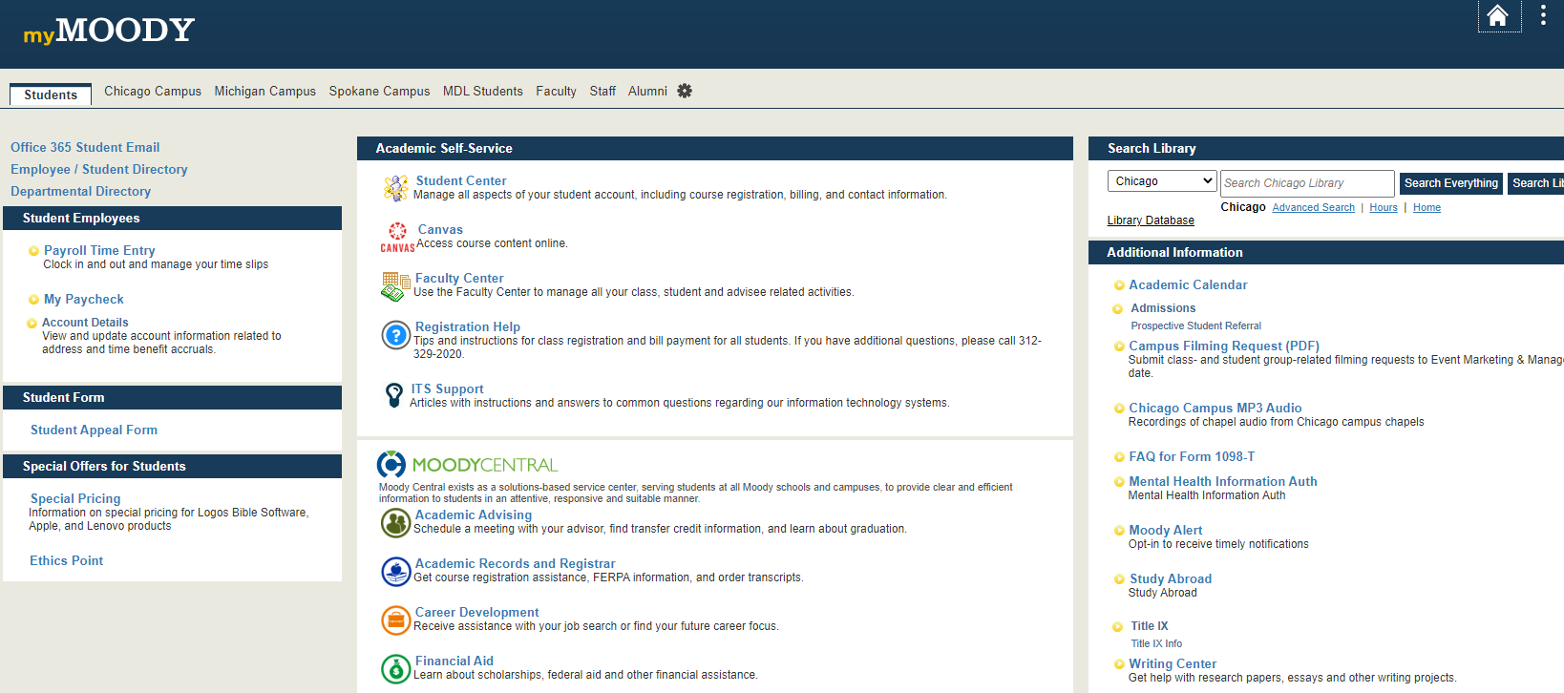
This is the “Student Portal”

Slide 4
Student Portal: Moody Email Overview
Click on “Office 365 Student Email” to get to the Moody email log-in

Slide 5
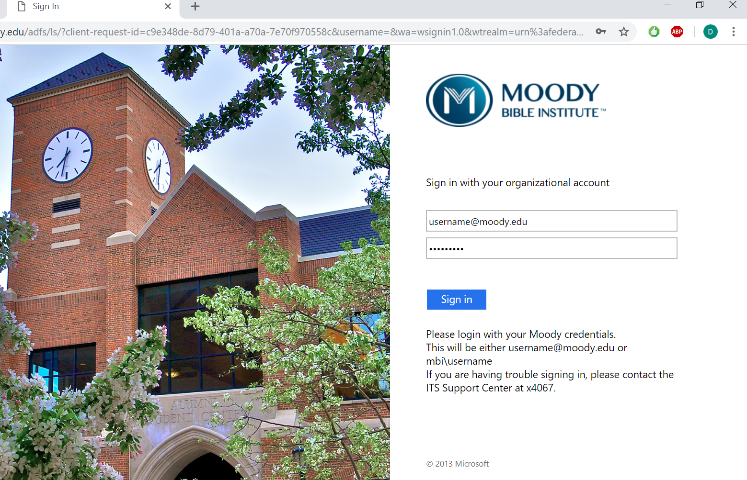
How to: Access Moody Email
1. In the username box, type in your username@moody.edu
2. In the password box, type in the same password that was used to log in to your student portal.
3. Click “Sign In”

Slide 6
Student Portal View

Slide 7
Student Portal: Student Center Overview
Click on “Student Center” to access all aspects of your student account

Slide 8
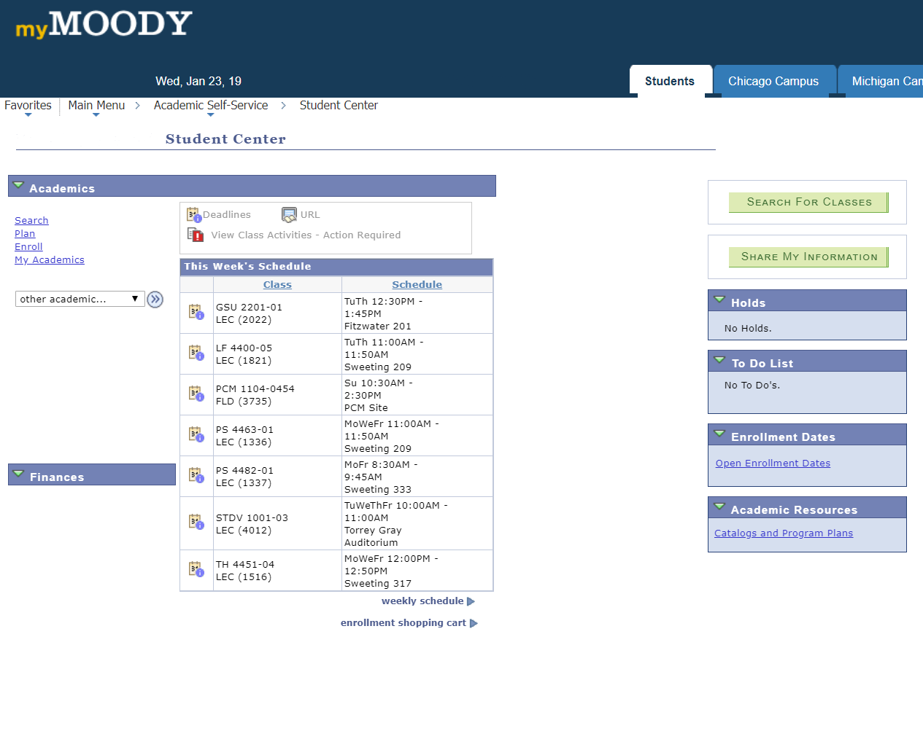
Student Center
Class Schedule: This section shows the courses that you are currently enrolled in.

Slide 9
Student Center
Holds: This section indicates if there is a hold on your account. A hold will prevent future enrollment until the hold is removed.

Slide 10
Student Center
To Do List: This section lists important items to complete. Clicking on a To Do List item will detail the action required.

Slide 11
Student Center
Enrollment Dates: Provides a list of “Open Enrollment Dates.”
Meaning, the list of dates and times a student can register for classes prior to the start of a new term.

Slide 12
Student Center
Academic Resources: Provides a link to the catalogs and program plans.
The catalog can be used to find important information such as refunds, length of courses, academic policies, a school year calendar, etc.
Program plans are used to easily track which courses you need to take in order to graduate.

Slide 13
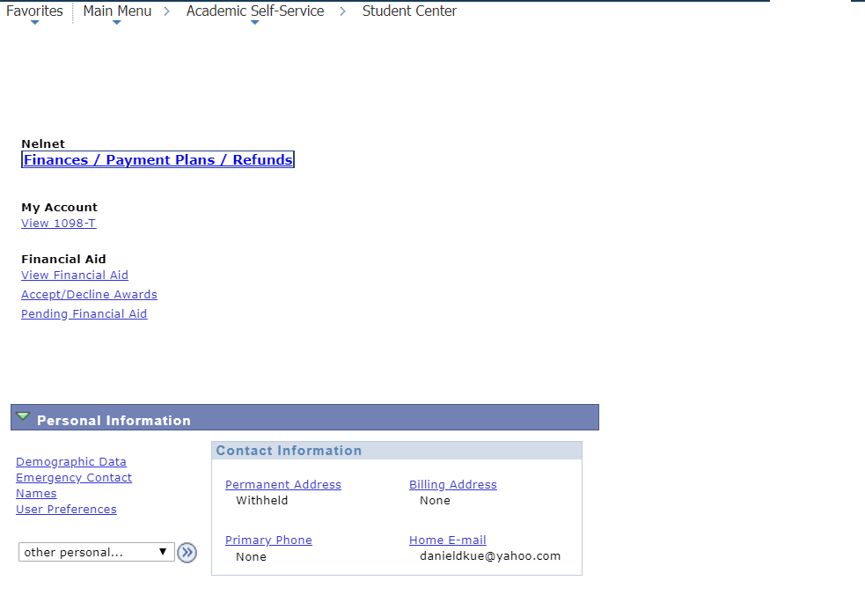
Student Center
Nelnet: The Finances/ Payment Plans/Refunds link will bring you to your Nelnet account.
You can make payments, set up a payment plan, and view your financial aid and refunds there.

Slide 14
Student Center
My Account: This is where you will access your 1089-T tax form.
This form contains information needed to file your taxes.

Slide 15
Student Center
View Financial Aid: Access your financial aid award summary.
This includes a breakdown of what you received in the form of loans, grants or scholarships by school year.

Slide 16
Student Center
Accept/Decline Awards: Here, you will be able to either accept or decline federal student loans.

Slide 17
Student Center
Personal Information: Here, you will be able to update your information such as your name, phone number, address, email and emergency contact.
Please keep your contact information up to date!

Slide 18
How to: Register for Classes
1. Click on Search for Classes.

Slide 19
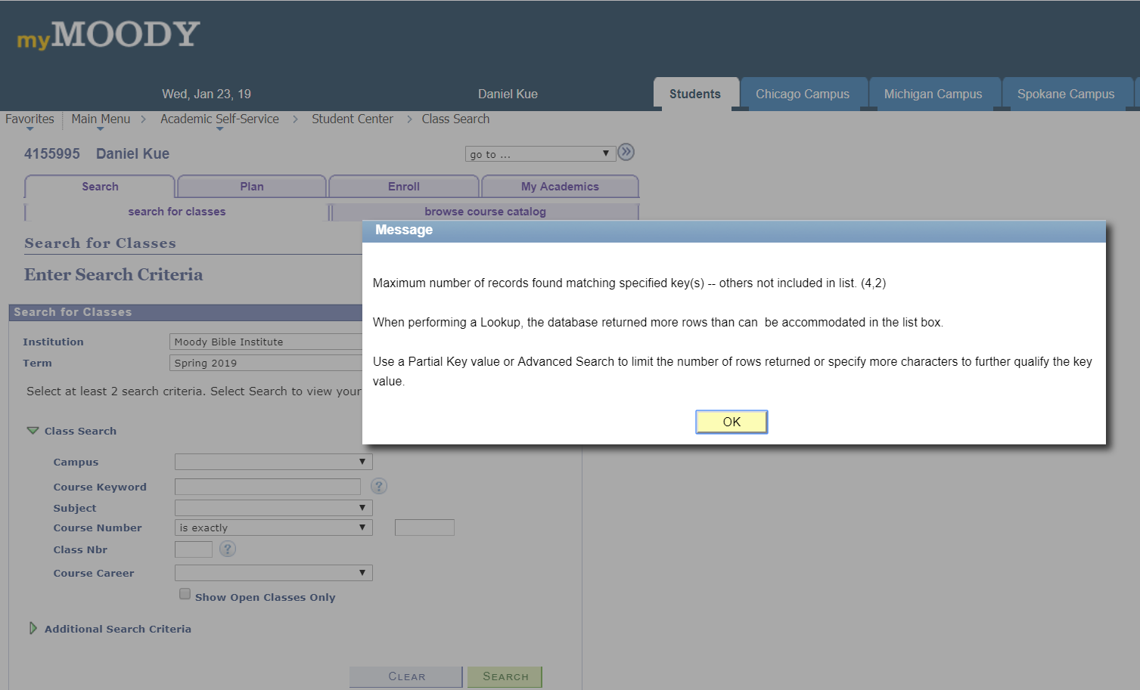
How to: Register for Classes
1. Click on Search for Classes.
2. You will see a pop-up message. Always click on OK.

Slide 20
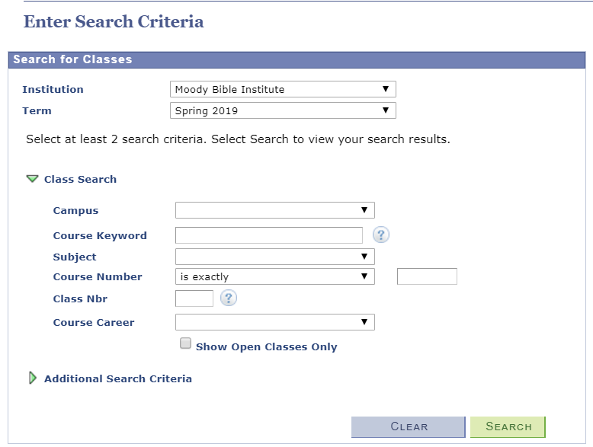
How to: Register for Classes
1. Click on Search for Classes.
2. You will see a pop-up message. Always click on OK.
3. Search for Classes
- Institution: Make sure it says, “Moody Bible Institute”.

Slide 21
How to: Register for Classes
1. Click on Search for Classes.
2. You will see a pop-up message. Always click on OK.
3. Search for Classes
- Institution: Make sure it says, “Moody Bible Institute”.
- Term: Select the Semester that you want to enroll into.

Slide 22
How to: Register for Classes
3. Search for Classes
- Institution: Make sure it says, “Moody Bible Institute”.
- Term: Select the Semester that you want to enroll into.
- Campus: If you are taking an online 8-week course, select “Online”. For a 16-week course, select “Online Self-Paced.”

Slide 23
How to: Register for Classes
3. Search for Classes
- Institution: Make sure it says, “Moody Bible Institute”.
-Term: Select the Semester that you want to enroll into.
- Campus: Select your venue of class. If you are taking an online 8-week course, please select “Online”. For a 16-week course, select “Online Self-Paced”.
- Course Number: Input the course number found in the Program Plan, i.e. 1107

Slide 24
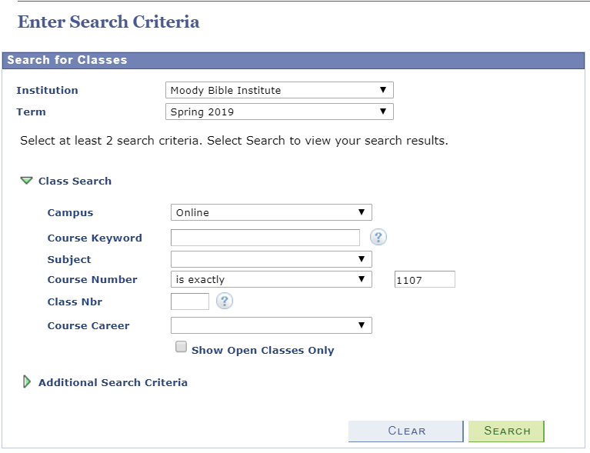
Here is an example:
- The class search requires at least two of the six class search criteria to work.
- Searching for classes usually works best if only the Campus and Course Number are filled out. Leave everything else blank.

Slide 25
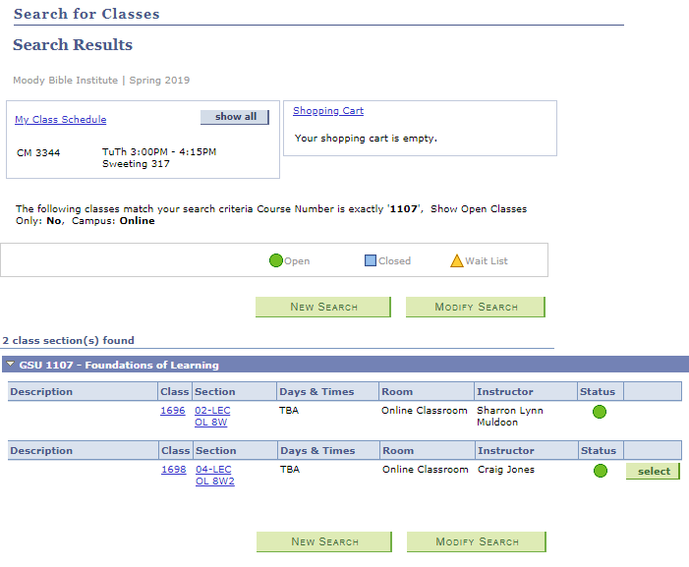
How to: Register for Classes
4. Search Results
- This the name of the course.

Slide 26
How to: Register for Classes
4. Search Results
- This the name of the course.
- Section: This indicates the session that the course will occur. OL8W indicates that the course will be offered in the first 8-week session. OL8W2 indicates that the course will be offered in the second 8-week session.

Slide 27
How to: Register for Classes
4. Search Results
- This the name of the course.
- Section: This indicates the session that the course will occur. OL8W indicates that the course will be offered in the first 8-week session. OL8W2 indicates that the course will be offered in the second 8-week session.
- Instructor: This indicates the name of the assigned professor.

Slide 28
How to: Register for Classes
4. Search Results
- This the name of the course.
- Section: This indicates the session that the course will occur. OL8W indicates that the course will be offered in the first 8-week session. OL8W2 indicates that the course will be offered in the second 8-week session.
- Instructor: This indicates the name of the assigned professor.
- Status: This indicates if the course has open slots. Please refer to the key above.

Slide 29
How to: Register for Classes
4. Search Results
- This the name of the course.
- Section: This indicates the session that the course will occur. OL8W indicates that the course will be offered in the first 8-week session. OL8W2 indicates that the course will be offered in the second 8-week session.
- Instructor: This indicates the name of the assigned professor.
- Status: This indicates if the course has open slots. Please refer to the key above.
- Select: This only appears if the registration is open.

Slide 30
How to: Enroll into the course
5. Enroll into course
- Click on the select button to choose the course that you want to enroll in.

Slide 31
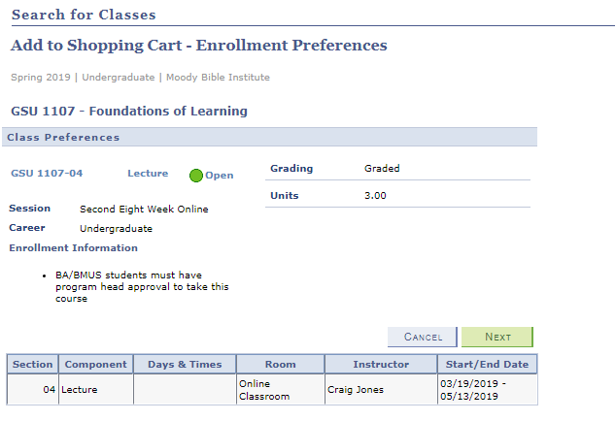
How to: Enroll into the course
5. Enroll into course
- Click on the select button to choose the course that you want to enroll in.
- Click on the “NEXT” button.

Slide 32
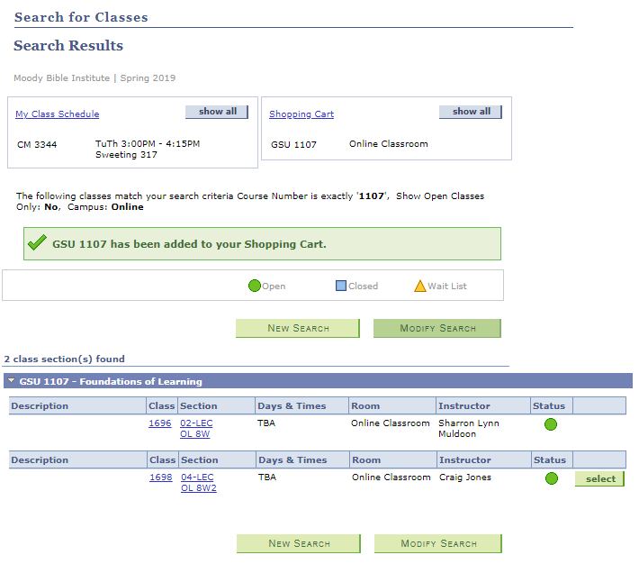
How to: Enroll into the course
5. Enroll into course
- Click on the select button to choose the course that you want to enroll in.
- Click on the “NEXT” button.
- If successful, you will see a green box notifying you that the course has been added to your shopping cart.

Slide 33
How to: Enroll into the course
5. Enroll into course
- Click on the select button to choose the course that you want to enroll in.
- Click on the “NEXT” button.
- If successful, you will see a green box notifying you that the course has been added to your shopping cart.
- Click on the shopping cart.

Slide 34
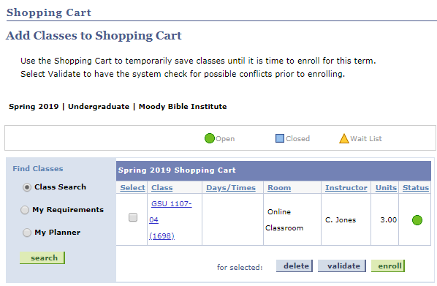
How to: Enroll into the course
5. Enroll into course
- Click on the select button to choose the course that you want to enroll in.
- Click on the “NEXT” button.
- If successful, you will see a green box notifying you that the course has been added to your shopping cart.
- Click on the shopping cart.
- Check the box to select the course.

Slide 35
How to: Enroll into the course
5. Enroll into course
- Click on the select button to choose the course that you want to enroll in.
- Click on the “NEXT” button.
- If successful, you will see a green box notifying you that the course has been added to your shopping cart.
- Click on the shopping cart.
- Check the box to select the course.
- Click on the “Enroll” button.

Slide 36
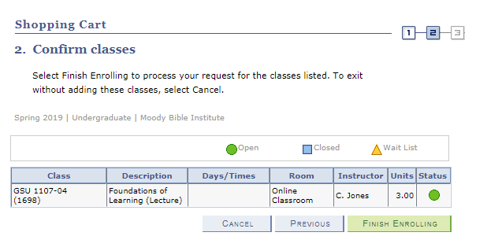
How to: Enroll into the course
5. Enroll into course
- Click on the select button to choose the course that you want to enroll in.
- Click on the “NEXT” button.
- If successful, you will see a green box notifying you that the course has been added to your shopping cart.
- Click on the shopping cart.
- Check the box to select the course.
- Click on the “Enroll” button.
- Click on the “Finish Enrolling Button”.

Slide 37
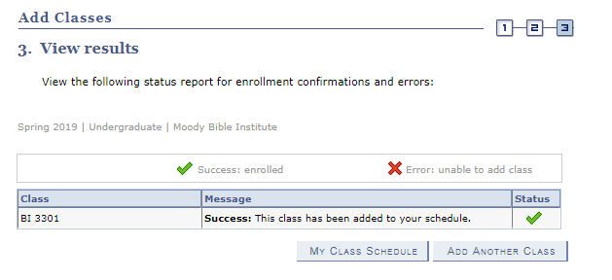
How to: Enroll into the course
You have now successfully enrolled into your course!

Slide 38
Canvas: Course Content
All course content such as videos, zoom links, and syllabi can be accessed through Canvas.
Canvas courses become available 3-4 days before the course begins.

Slide 39
Academic Advising

Slide 40
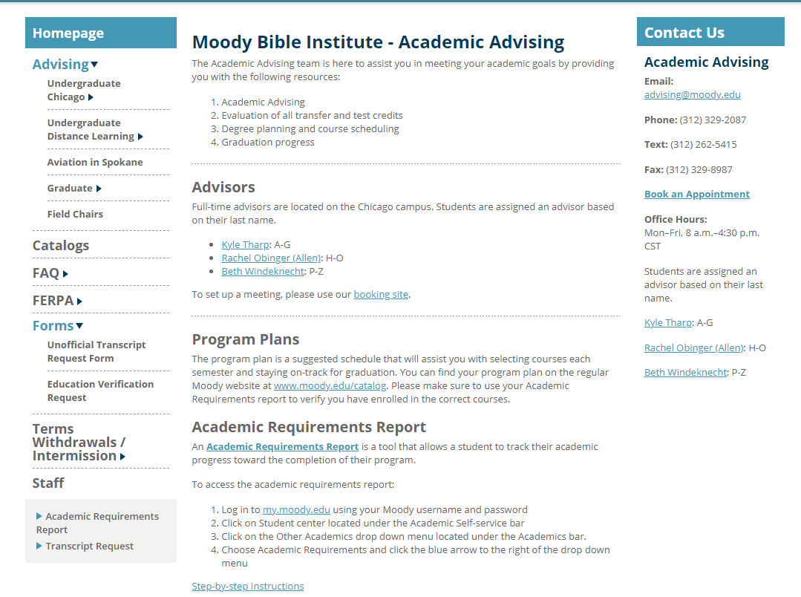
Academic Advising
-To locate and contact your assigned Academic Advisor, click on their name to send an email.

Slide 41
Academic Advising
-To locate and contact your assigned Academic Advisor, click on their name to send an email.
-Click here to book an appointment with your Academic Advisor

Slide 42
Academic Requirements Report
-To locate your academic requirement page, please follow the instructions listed below.

Slide 43
Setting up FERPA Authorization

Slide 44
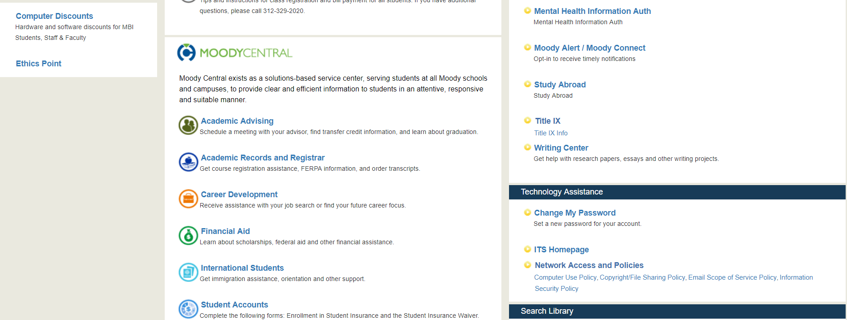
Student Portal View
Click on Academic Records and Registrar to find “FERPA”

Slide 45
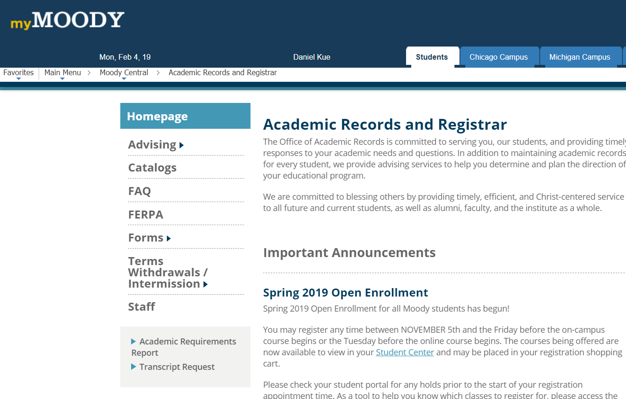
How to: Set up FERPA Authorization
- Click on “FERPA”

Slide 46
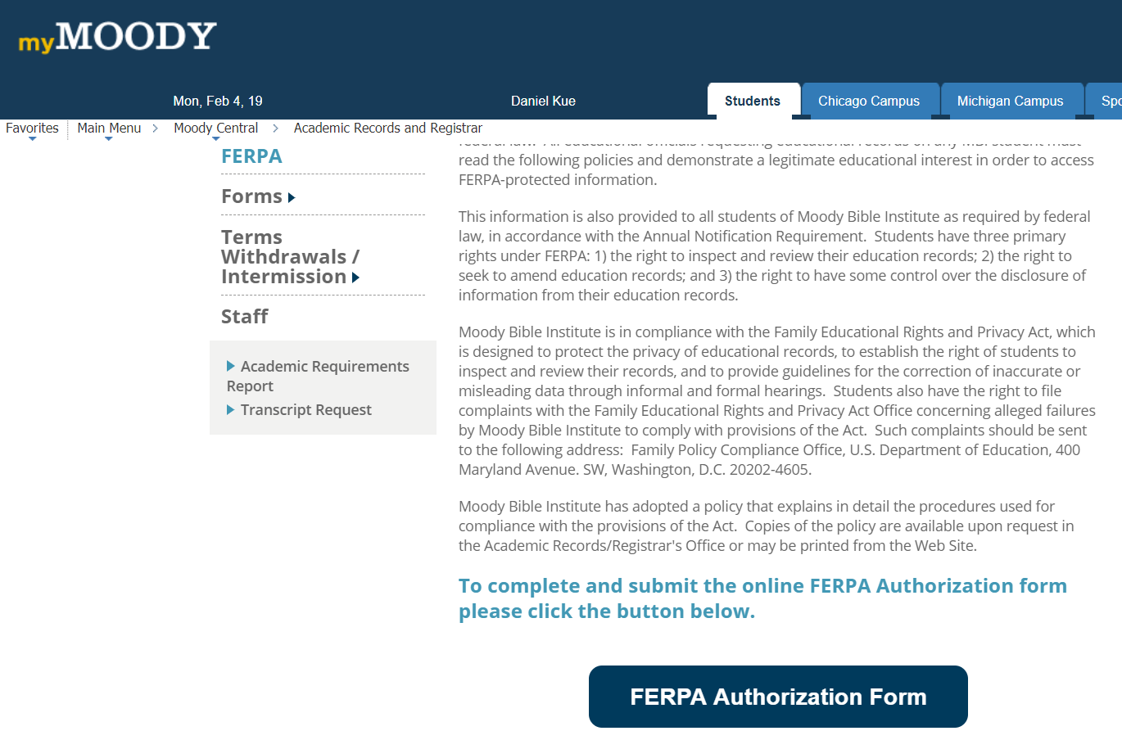
How to: Set up FERPA Authorization
- Click on “FERPA”
- Click on “FERPA Authorization Form”

Slide 47
Student Portal View
Select “Financial Aid” to find more information

Slide 48
Student Accounts
The Student Accounts tab houses various resources such as instructions on paying student bills, FERPA, taxes and more.

Slide 49
Institutional Scholarships

Slide 50
How to: Apply for Institutional Scholarships
- Moody offers a limited amount of scholarships that students are able to apply for.
- Scholarship applications can be accessed from the Financial Aid section of the Student Portal.

Slide 51
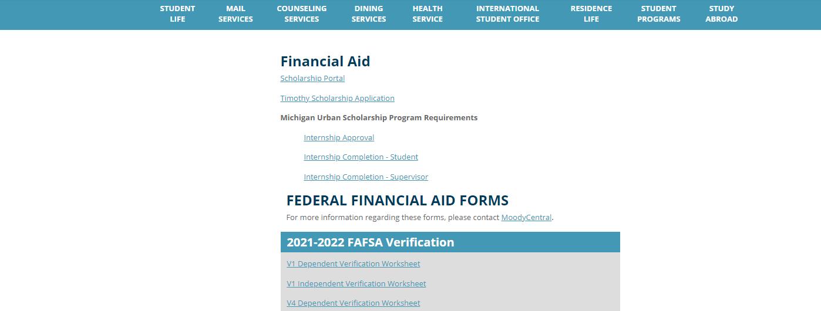
How to: Apply for Institutional Scholarships
To apply for an Institutional Scholarship, select the link and fill out the application.
The Timothy scholarship is specifically for Graduate Students and needs to be completed each semester.

Slide 52
Academic Calendar

Slide 53
Student Portal View

Slide 54
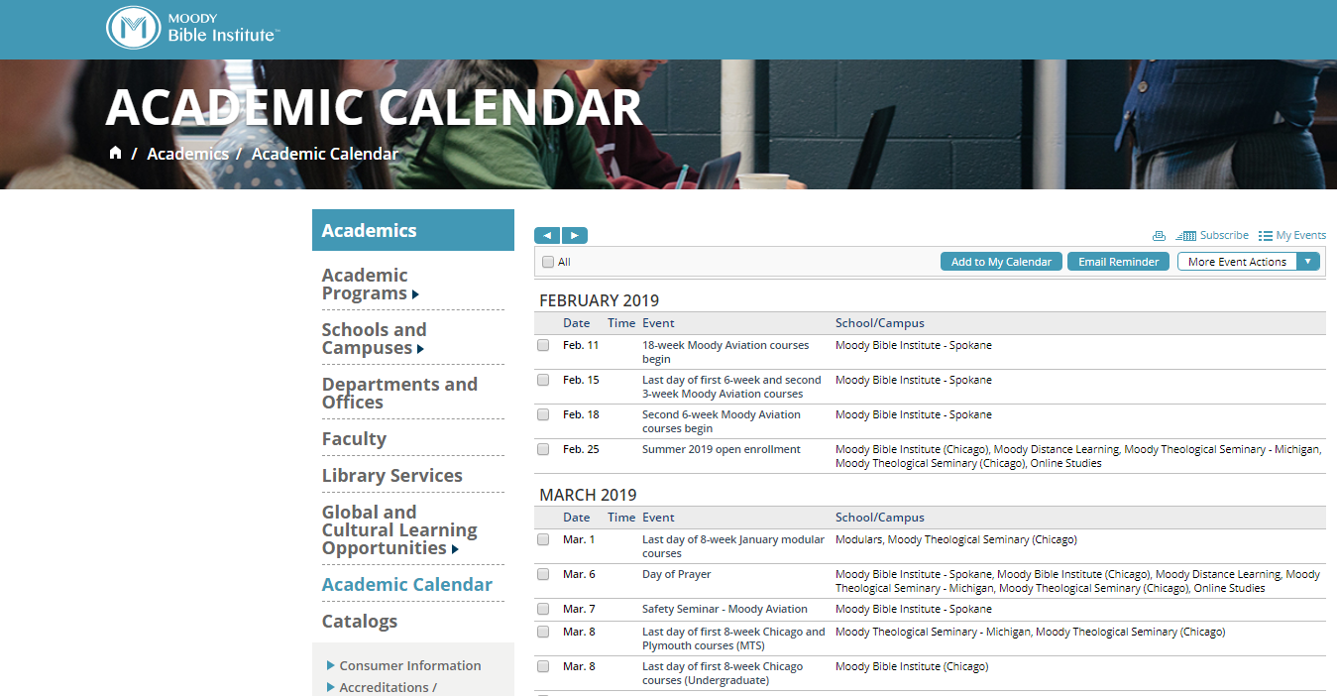
How to: Access the Academic Calendar
- The Academic Calendar has important dates for the school year.
- This includes start dates, events, and even what’s happening at other campuses.

Slide 55
Writing Center

Slide 56
How to: Find the Writing Center
- If a student desires to receive assistance in writing papers and constructive criticism on their work the Writing Center is the place to go!

Slide 57
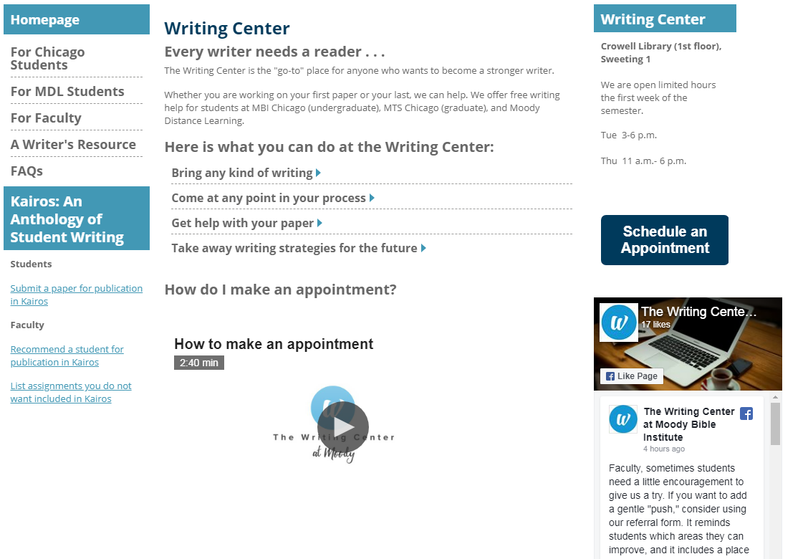
How to: Find the Writing Center
- First, check out the video that shows you how to set up an appointment with a tutor.

Slide 58
How to: Find the Writing Center
- Click “schedule an appointment” to get registered.

Slide 59
EBSCO Database

Slide 60
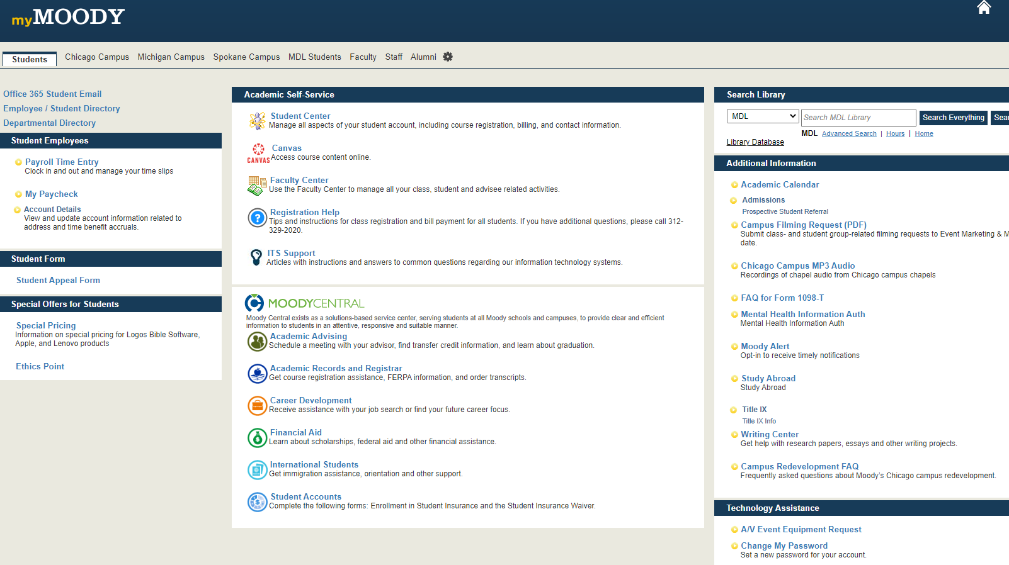
How to: Get to and Use EBSCO Database
- One of the many great perks of being an MDL student is the ability to access scholarly peer reviews, articles, journals, and eBooks through EBSCO’s Database.

Slide 61
How to: Get to and Use EBSCO Database
- Select the drop down tab beneath “Search Library” and choose the option that pertains to you (MDL).

Slide 62
How to: Get to and Use EBSCO Database
- Type in the name of a source or topic of interest
- Click on “Search Everything”

Slide 63
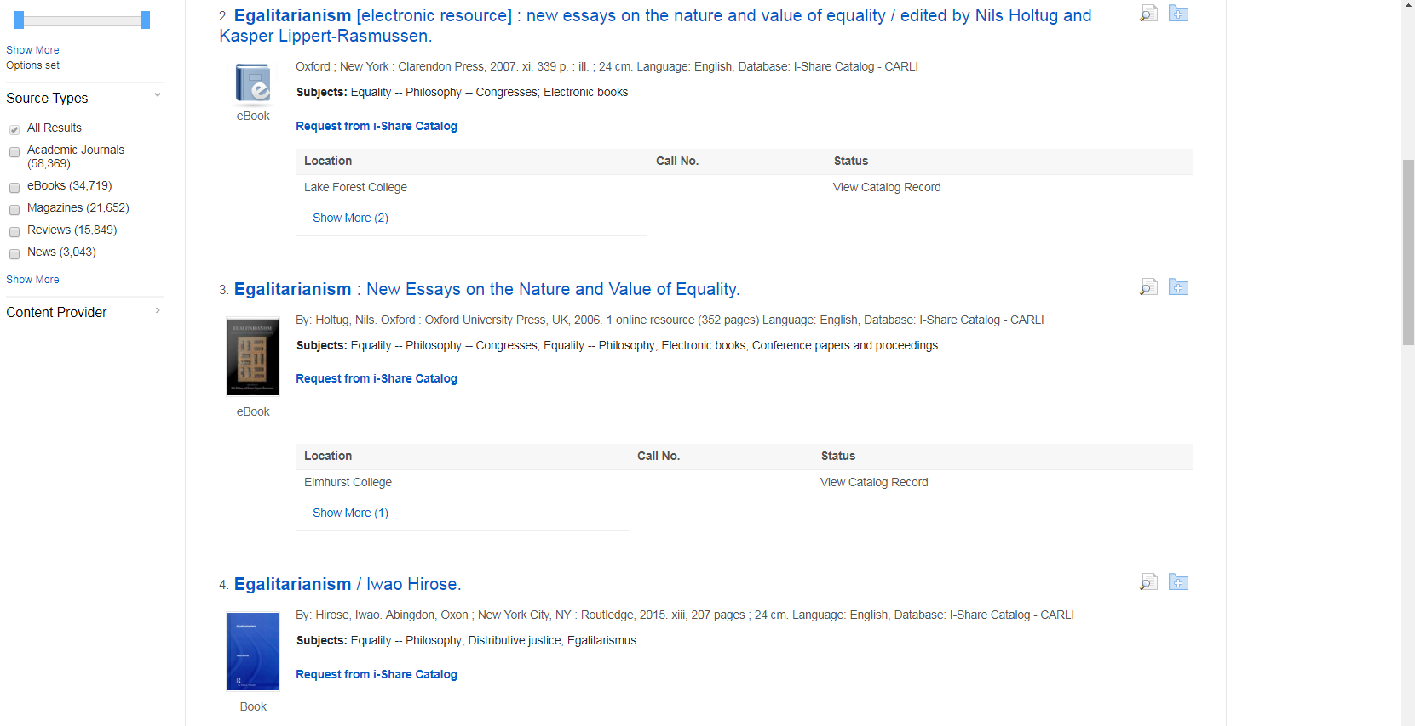
How to: Get to and Use EBSCO Database
- To refine your search results, you can narrow down your search in the “Source Types”

Slide 64
How to: Change your Password

Slide 65
Student Portal View

Slide 66
How to: Find Your Required Textbooks

Slide 67
Student Portal View
Go to the MDL Students/ Online Students tab to find your required textbooks/ Sample Syllabus

Slide 68
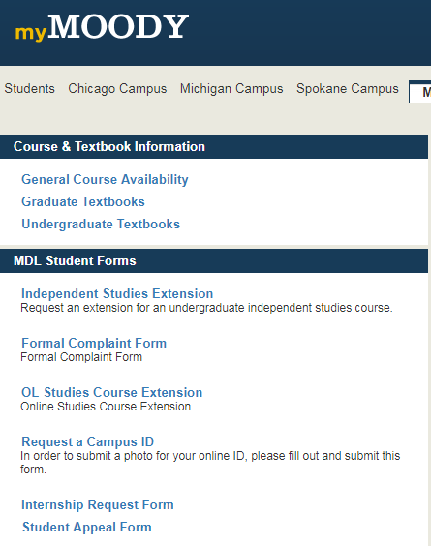
How to: Find Your Required Textbooks/ Sample syllabus
- Select your textbooks list.

Slide 69
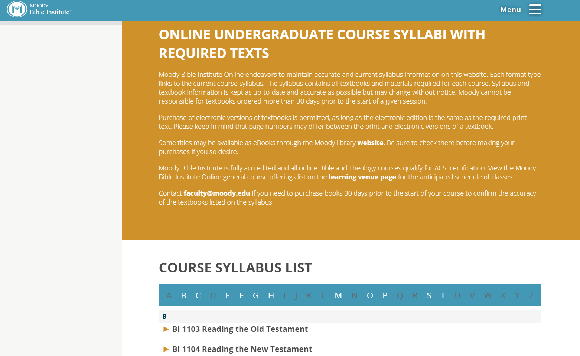
How to: Find your Required Textbooks/ Sample Syllabus
Find your course listed alphabetically by course number.
Click on the arrow of your selected course

Slide 70
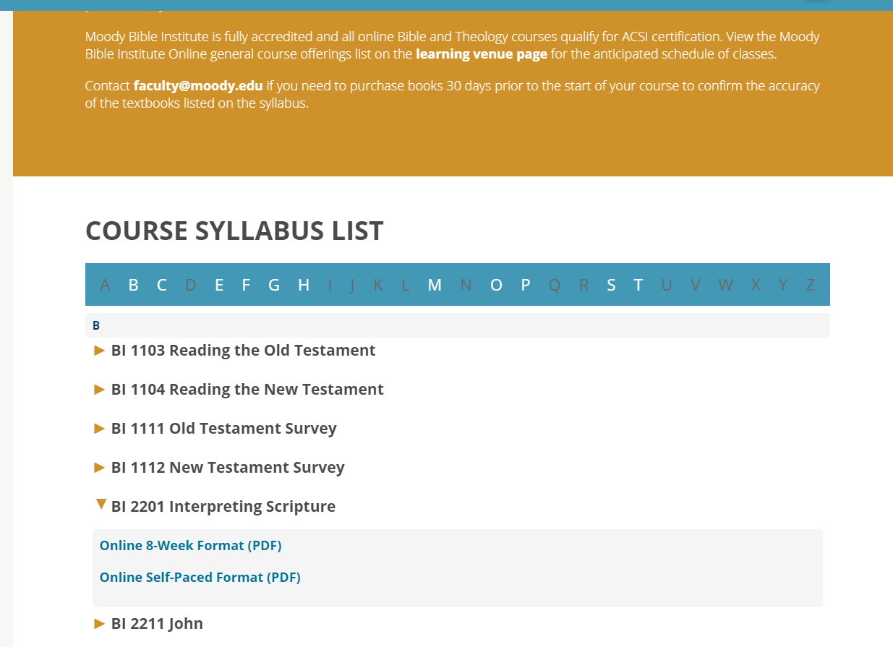
How to: Find your Required Textbooks/ Sample Syllabus UNDERGRADUATE VIEW
Purchase the textbooks listed on your sample syllabus under “Course Materials (required) .”
We recommend students to wait until a month before classes start to purchase books to assure most accurate required book listing.
Courses are offered either as an 8-week or Self-Paced course. Make sure to look out for that!

Slide 71
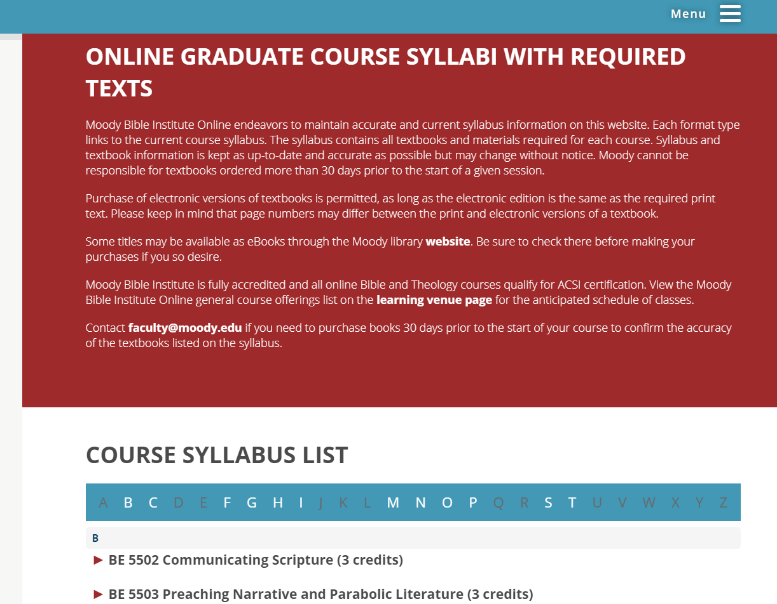
How to: Find your Required Textbooks GRADUATE VIEW
All graduate students should have received an email from the Moody Logos Admin detailing what the Logos Bible Software is and how to purchase it.
Students in the Counseling, TESOL, non-degree or Certificate programs are NOT required to purchase LOGOS.
If the student has any questions about this, they can contact their Grad Student Success Coach or logos4moodyseminary@moody.edu

Slide 72
General Course Availability

Slide 73
Student Portal View

Slide 74
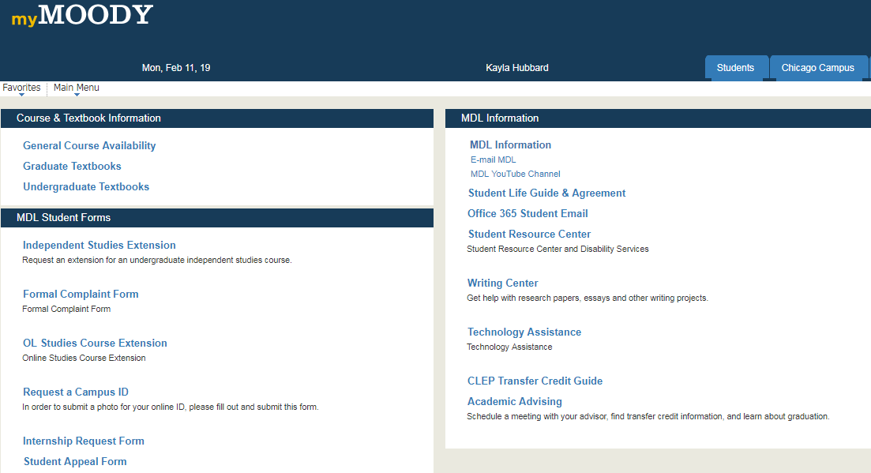
Student Portal:
General Course Availability
Select “General Course Availability” to access a PDF of the courses being offered in the current school year.

Slide 75
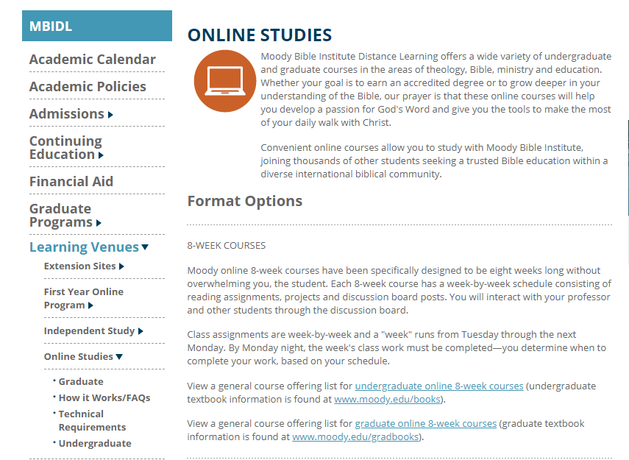
How to: View General Course Availability
Locate the desired course offering (either undergrad or grad) and click on the blue link to access the PDF.

Slide 76
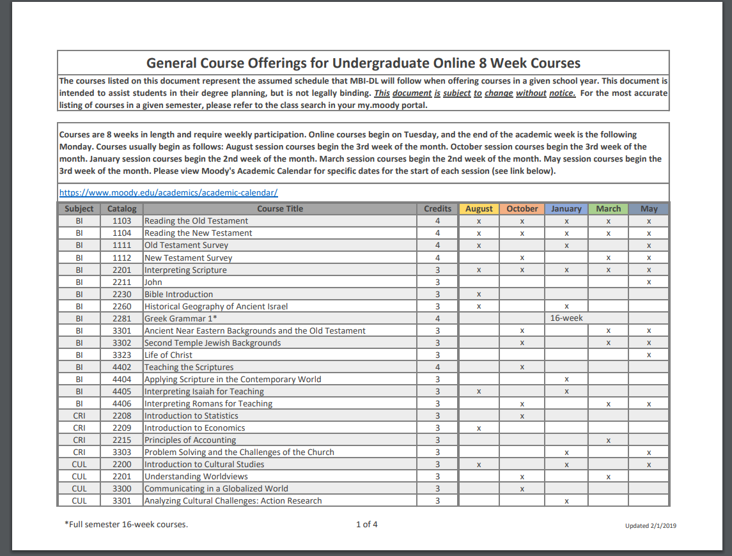
How to: View General Course Availability
Students can use this chart to determine whether a course is offered during the current school year, as well as which session(s) the course is offered in.
If a course is offered in a particular session, this will be indicated by an X under the term it is offered in.

Slide 77
MDL Student Handbook

Slide 78
Student Portal View

Slide 79
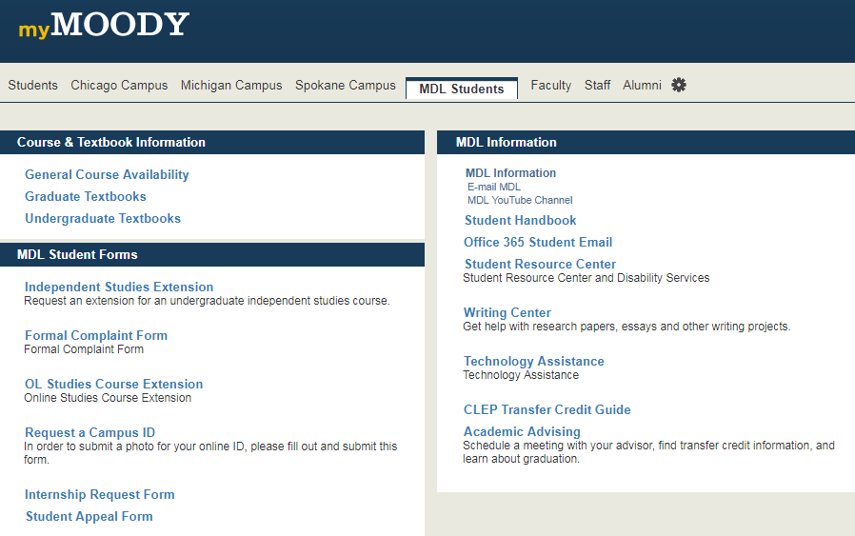
MDL Student Handbook
The MDL Student handbook contains important information on MDL’s academic policies such as course drops and refunds, extensions, change of program procedures, and tuition and grade appeals.

Slide 80
MTS Student Handbook
The MTS Student Handbook can also be view in the same link to review important information on MTS’s academic policies such as course drops and refunds, extensions, change of program procedures, and tuition and grade appeals.

Slide 81
Student Resource Center
If you anticipate or experience barriers to format, requirements, or assessment of courses you are encouraged to contact Gayla Gates.
Accommodations will be made on an individual basis. Contact Gayla Gates, ggates@moody.edu

Slide 82
Have Additional Questions?
For Undergrad assistance,
please call 1-800-758-6352
For Seminary assistance,
please contact 1-800-955-1123

